Slide 1
predicting THYROID cancer
brooks Jones

Slide 3
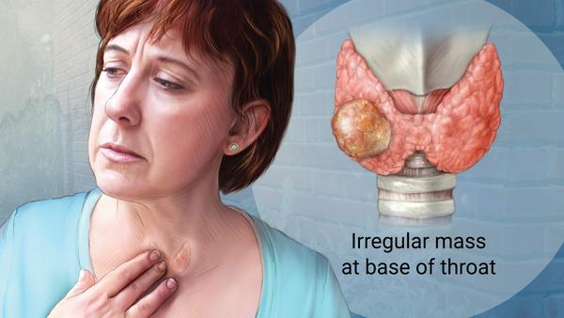
What problem are we trying to solve
How can thyroid cancer be predicted from examining a data set of patients.

Slide 4
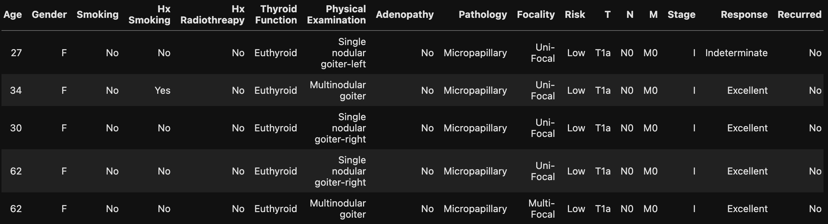
Problem as it relates to data science
How can thyroid cancer be better predicted from examining this data set?
This data set was provided by Kaggle and is a list of patients and associated metrics related to their health and thyroid cancer prediction metrics.

Slide 5
Data Wrangling
This data set was exceptionally clean so there wasn’t any wrangling that needed to be done for this data set.

Slide 6
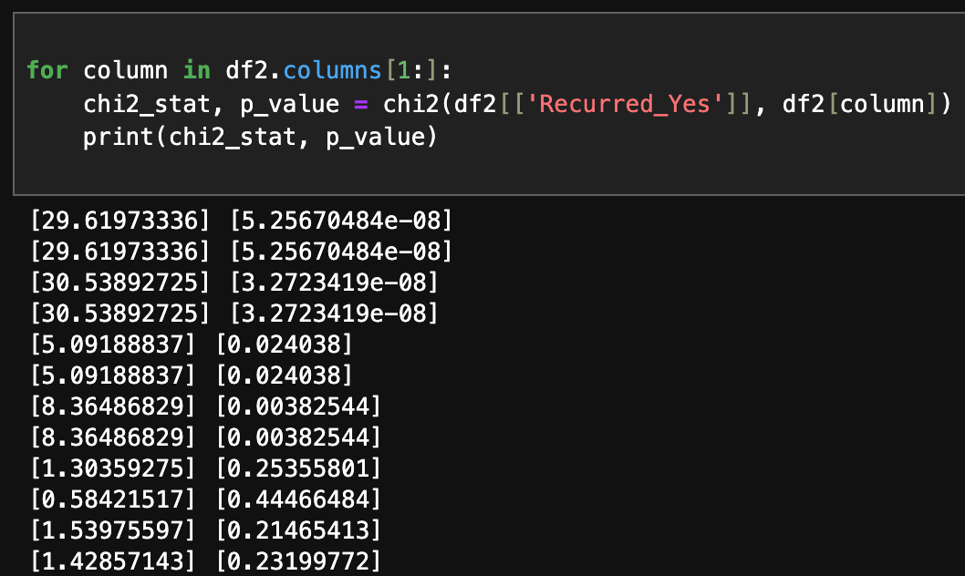
EDA
We explored the data set by running a t-test and chi squared test to test for correlation of the data set.
We ran a t-test for the numerical age column as it related to the rest of the categorical data set.
We also ran a chi–squared on the Recurred_Yes column as it related to the other categorical variables.

Slide 7

Modeling
NAÏVE BAYES
SUPPORT VECTOR MACHINE (SVM)
DECISION TREE

Slide 8
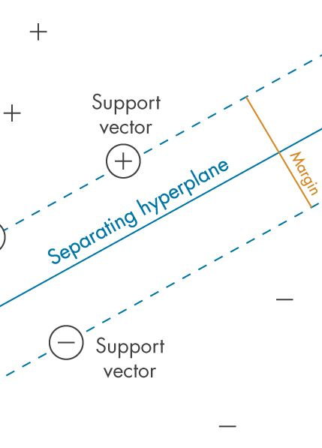
Modeling
These three models were chosen because they are heavily used in the medical field for predicting cancer in patients.
SVM being the most heavily favored model, we had high hopes for this model.

Slide 9
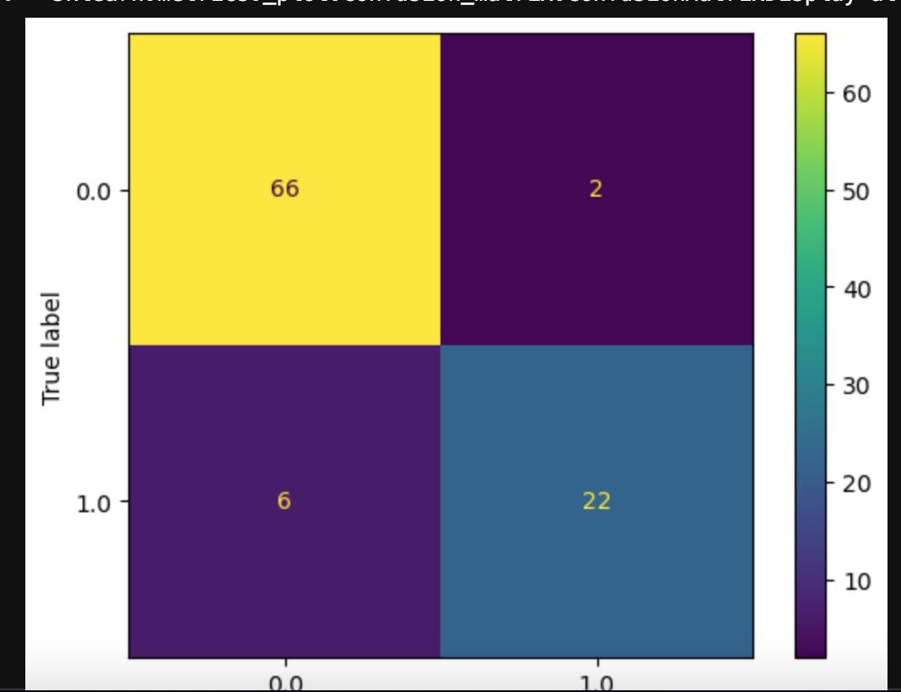
Analysis Results
Of the three models used, SVM had the highest performing results with precision (96.15%), recall (89.29) and an AUC (94%).
Cross validation was also ran on the training set and had a recall score of (84.71%).

Slide 10
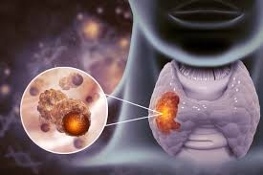
Recommendations
Through this data set we were able to correctly predict thyroid cancer with a recall of 89.2% and a precision of 96.15%.
Doctors will be able to implement this analysis for new and existing patients in helping to predict thyroid cancer.
Health insurance providers will be able to use this analysis to prescreen clients for the possibility of having or getting thyroid cancer, and in turn helping clients seek treatment at the early stages of thyroid cancer

